Slide 1


KYC for Digital Finance Application
Engineering Internship Project Presentation
Soutenance de Stage Ouvrier
ÉCOLE POLYTECHNIQUE DE TUNISIE
Biware Solution
Elaborated by : Daoud Aymen
Supervised by : Nadia Jmour PHD specialist in AI

Slide 2

Summary
1
Introduction
2
Problem
3
Solution for KYC Software
4
Conclusion & Challenges

Slide 3

KARNY –Platform
Biware is a consulting and integration company works on:
• Developing AI-Powered solutions.
• Building, evaluating and testing new AI methodologies to solve specific problem using a dedicated research team.
• Delivering relevant and impactful Software solutions
KARNY offers Tunisian consumers the means to finance their purchases of between 50 and 500 DT on credit via deferred payments, without interest. The experience is 100% digital. For purchases over 500DT an additional fee is required
KARNY aims to serve populations who cannot or do not want to pay cash for necessary and/or emergency purchases.
4
École polytechnique de Tunisie

Slide 4
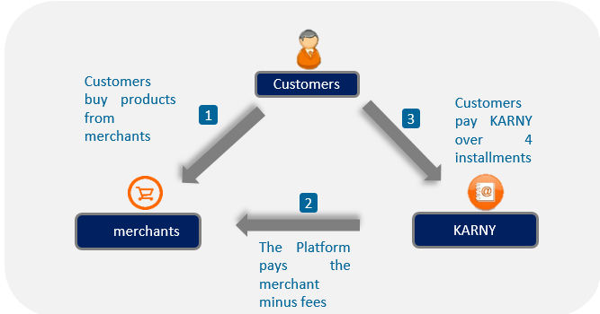
KARNY – Solution

Slide 5




Clients life cycle KARNY
analytics Tools
New client
Ancien Client
Risk Calculation
Profiling (Données du formulaire)
Behavioral scoring (client du commerçant)
Alternative scoring – Alternative Data
Score du parrain
➔ Combined score (1 or more sources )
Score de risque qui se base sur l’historique des transactions effectuées via la plateforme KARNY
KYC Fraud detection
Detection of fraudulent behavior:
Frequent new account creation
Excess demand for service
Clients Spoofing…
Identification of potentiel client
Variable threshold (gradually increases)
Based on customer value segmentation
Fixed threshold
➔ Minimum Risk
Customer Value Management
Customer Value Management:
Fidélisation
Upsell / cross sell
Anticipation du départ
Monitoring de la satisfaction
Customer acquisition (targeting based on pre-calculated scores)
6

Slide 6
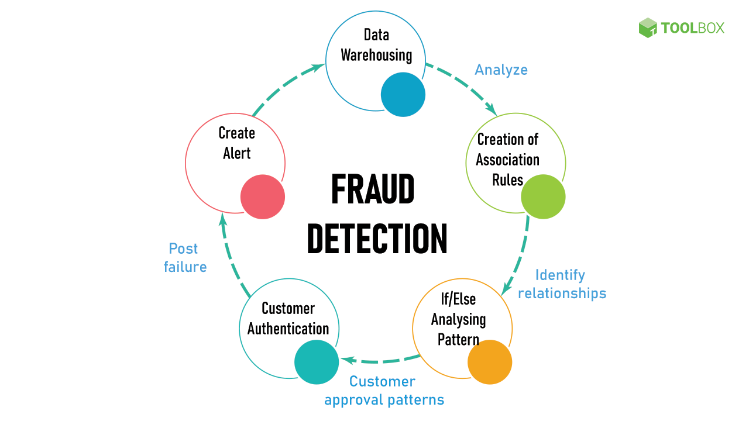
Main Problem
Fraud detection is a process that detects and prevents fraudsters or Hackers from obtaining money or property through false means.
Fraud detection is prevalent across banking, insurance, medical, government, and public sectors, as well as in law enforcement agencies.
Stage Ouvrier

Slide 7
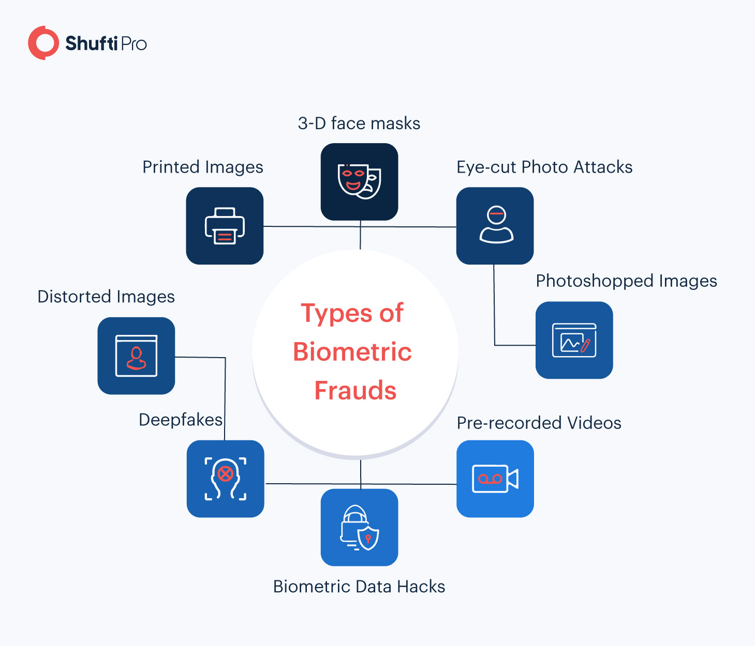

Slide 8


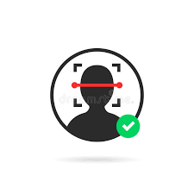

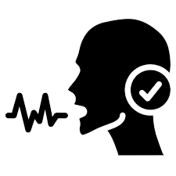
Solution
Liveness detection
Face matching
Speech recognition
OCR
Stage ouvrier

Slide 9
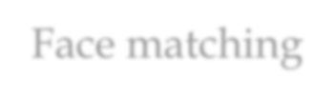
Technologies Used
Computer Vision for collecting ,processing and detecting images
Deep Learning model for OCR
CRAFT for text detection
ResNet for text recognition
LSTM for sequence labeling
Deep Learning model for Face Matching (Facenet)
Speech recognition developed by google AI

Slide 10
Face Matching

Slide 11
What is the difference between Face matching and Liveness Detection?
As we can see, there are some fairly significant differences between Face matching and Liveness Detection, however, the two are interlinked. The main difference is that
Liveness Detection refers to a system that can simply detect the presence of a human face in real time.
Face matching on the other hand takes this to the next level and is able to recognise and identify the detected face based on a match stored in a database.

Slide 12
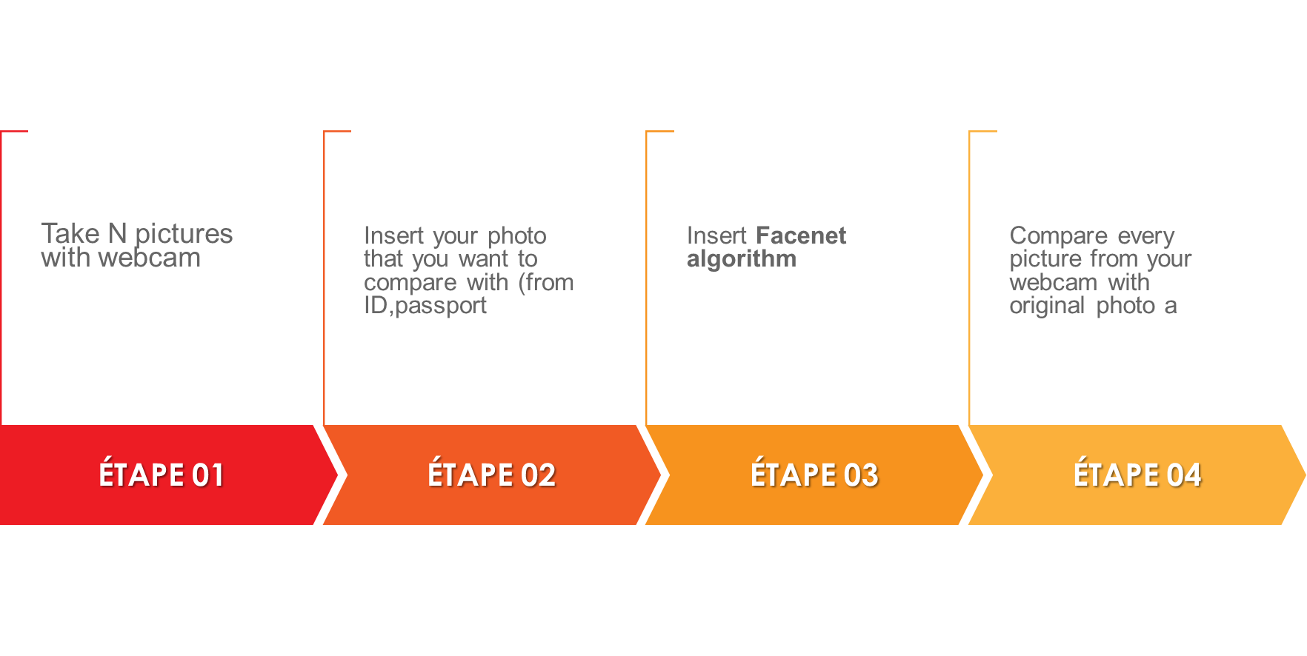
Face matching pipeline

Slide 13
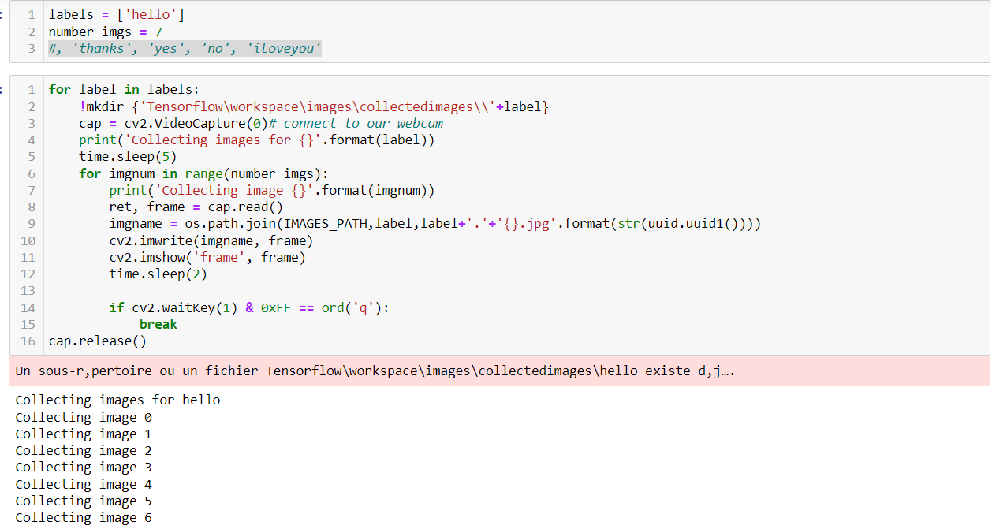

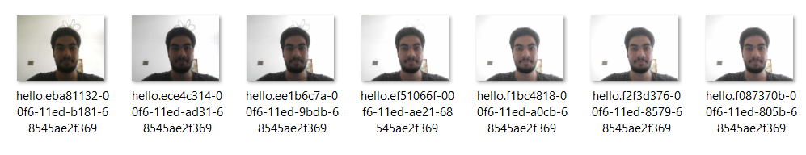
Face matching
Collecting Images

Slide 14

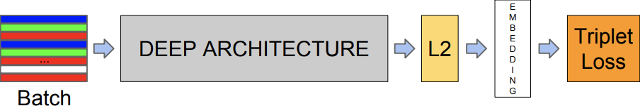
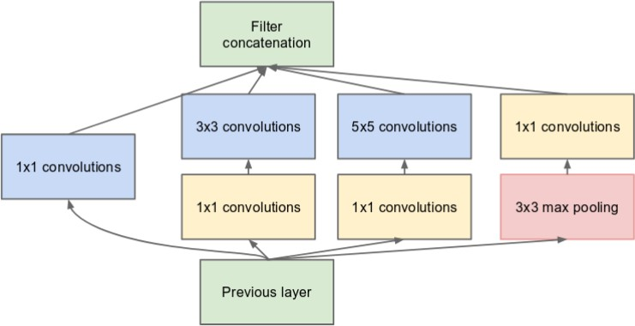
Deep learning-based approaches: FaceNet

Slide 15
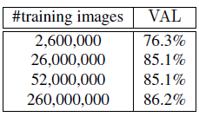
Why Facenet ?
A classification accuracy of 97.92% in LFW Dataset (Labeled Faces in the Wild)
A classification accuracy of 96.42% is achieved in YouTube Faces DB
École polytechnique de Tunisie

Slide 16
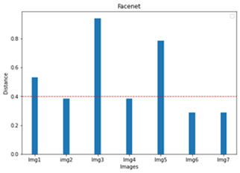
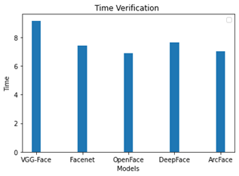
Why Facenet ?
École polytechnique de Tunisie

Slide 17
Extract Data from Image using OCR

Slide 18
What is Optical Character Recognition (OCR)?
OCR, or Optical Character Recognition, is a process of recognizing text inside images and converting it into an electronic form. These images could be of handwritten text, printed text like documents, receipts, name cards, etc.
OCR has two parts :
The first part is text detection where the textual part within the image is determined. This localization of text within the image is important for the second part of OCR,
text recognition, where the text is extracted from the image and identify words and characters.

Slide 19
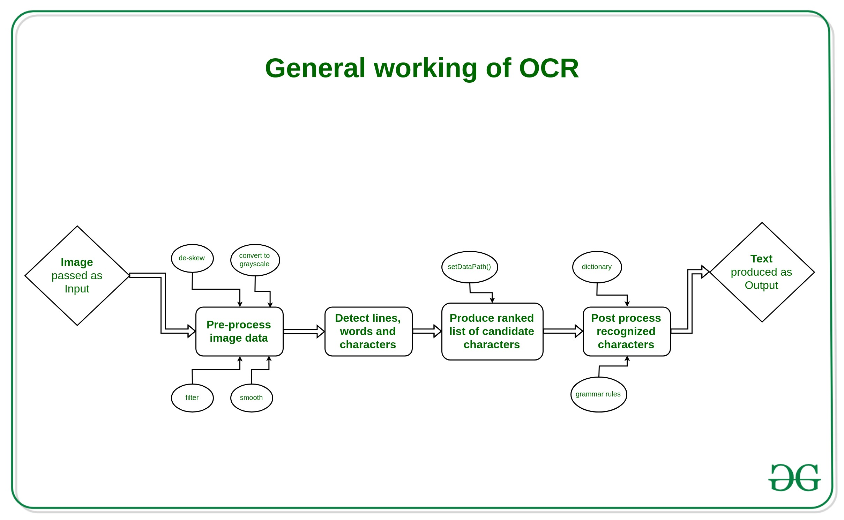

Slide 20
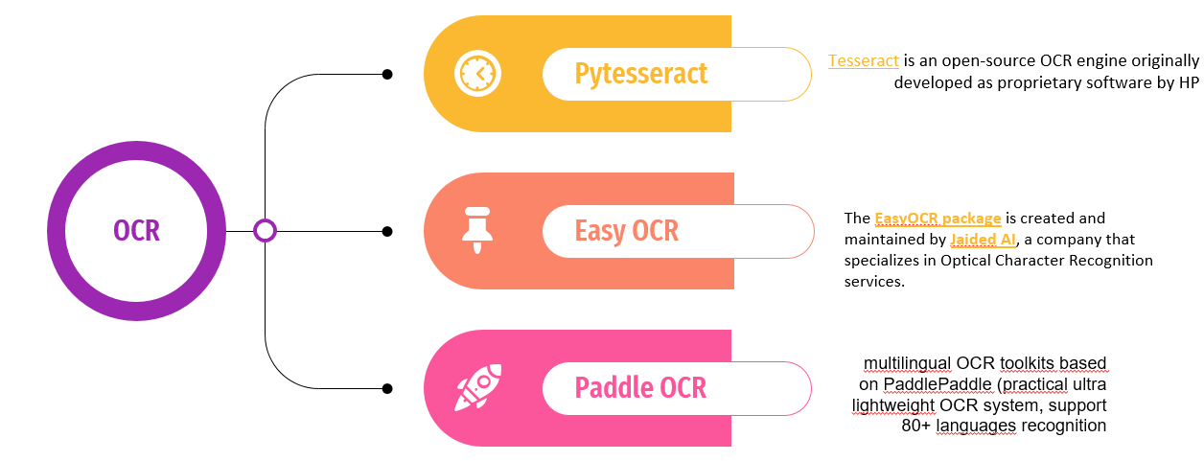
Extract Data from Image
Approach 1 Text Recognition with Tesseract OCR
Tesseract is an open-source OCR engine originally developed as proprietary software by HP (Hewlett-Packard)
Approach 2 Text Recognition with EasyOCR
The EasyOCR package is created and maintained by Jaided AI, a company that specializes in Optical Character Recognition services.
Approach 3 Text Recognition with PaddleOCR)
For each approach we work on 3 different card ID (eng – fr – ara)

Slide 21
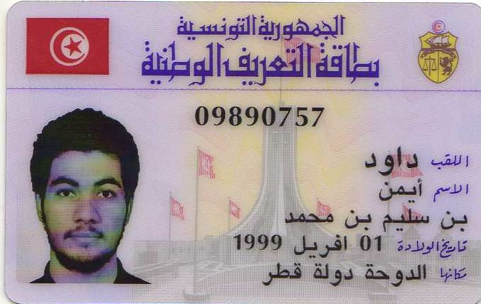
Extract Data from Image
Install libraries
import cv2
import numpy as np
import pytesseract
import matplotlib.pyplot as plt
import pandas as pd
from PIL import Image

Slide 22
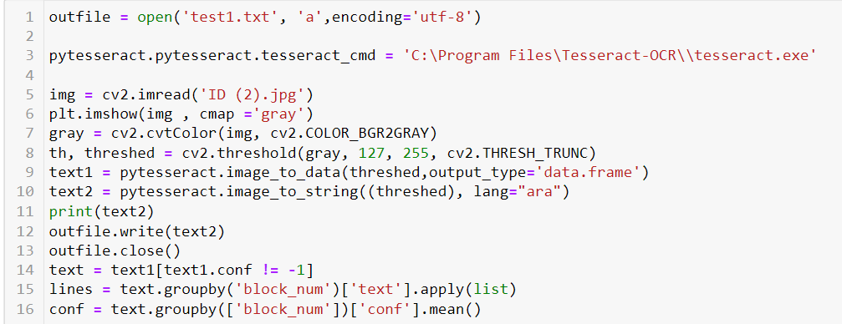
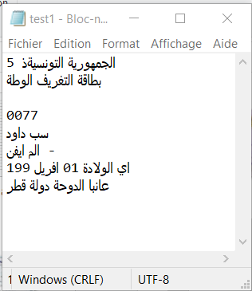
Extract Data from Image
Extracting Data and register the result in File.txt

Slide 23
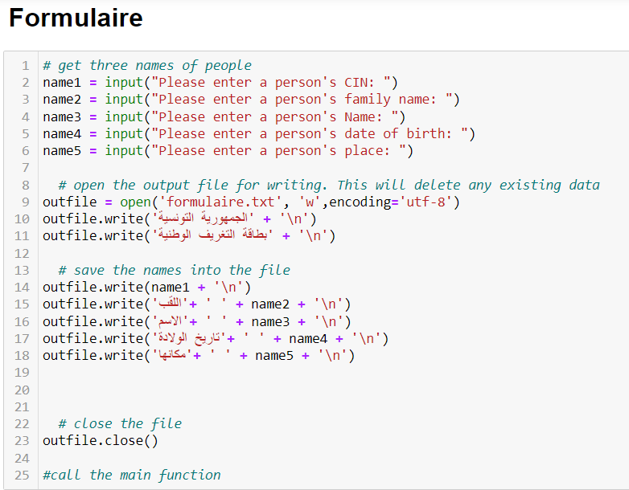
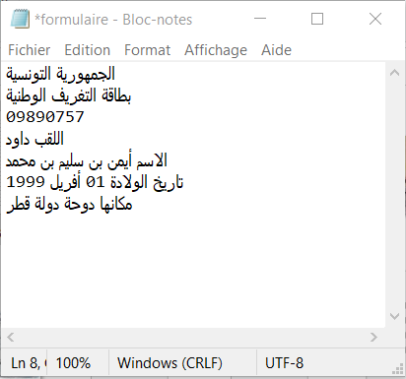
Extract Data from Image
Fill in the Form (Tunisian ID card)

Slide 24
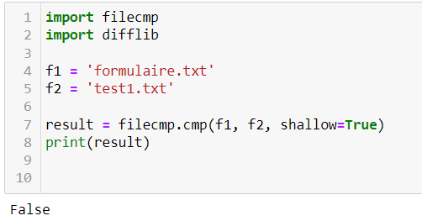
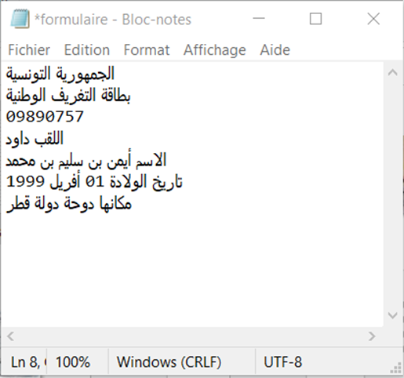
Extract Data from Image
Compare the 2 files

Slide 25
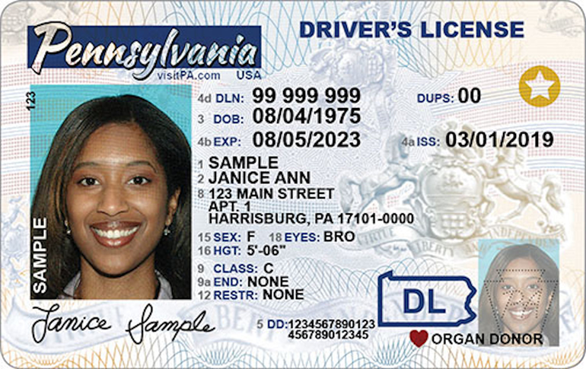
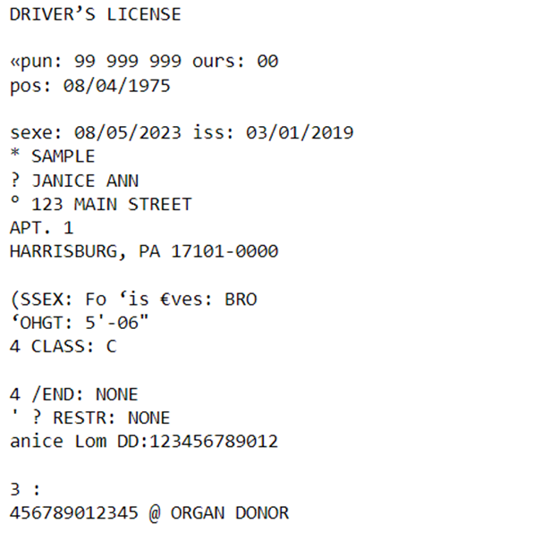
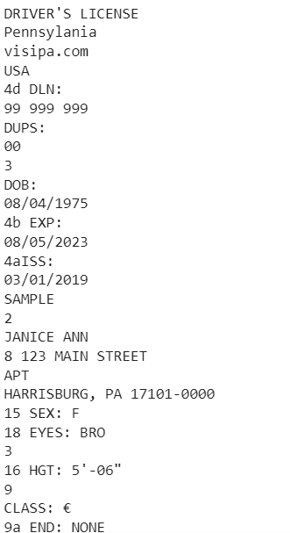
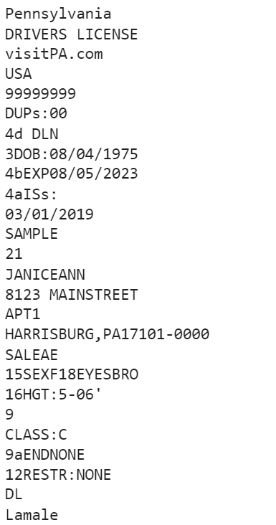
Extract Data from Image
Compare the results
Pytesseract
PaddleOCR
EasyOCR

Slide 26
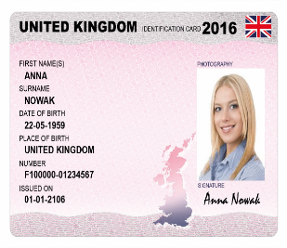
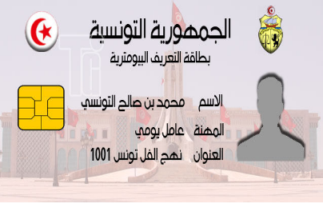
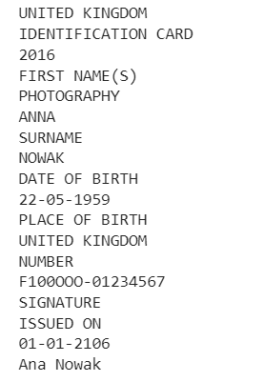
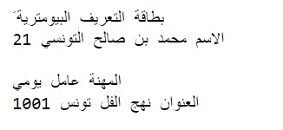
Extract Data from Image
Examples with 100% Accuracy

Slide 27
Conclusion
How we can expalin the errors
Different Language in one image
Blurry image
Using special style or small size for caracters
PaddleOCR gives the best result especially in english and french ID-Card
Solution
Improve the deep learning Architecture
Use MicroAzure cognitive services for OCR
implement advanced techniques in pre-processing and post-processing

Slide 28
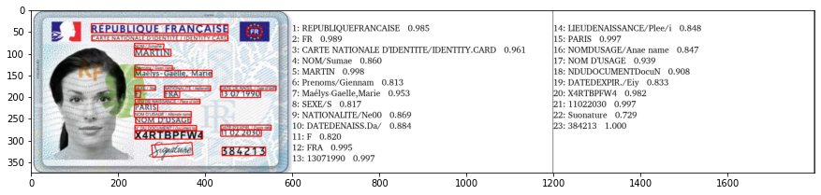
Conclusion
PaddleOCR also offers different models based on size.
Lightweight models – Models which take less memory and are faster but compromise on accuracy.
Server models (Heavyweight) – Models which take more memory but are more accurate but compromise on speed
.
PaddleOCR supports more than 80 languages (depending upon the OCR algorithm used)

Slide 29
Face liveness detection

Slide 30
Face liveness detection
Method 1
Build the image dataset itself.
Implement a CNN capable of performing liveness detector (we’ll call this network “LivenessNet”).
Train the liveness detector network.
Create a Python + OpenCV script capable of taking our trained liveness detector model and apply it to real-time video.
Method 2
Create a Python + OpenCV script capable of eye blinking detector in real-time video

Slide 31
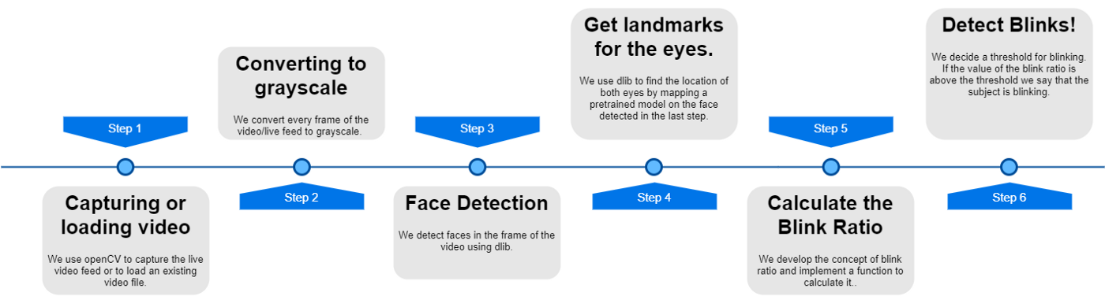
Face liveness detection
Approch‘s pipeline
Our approach in this presentation is to build up the implementation incrementally. We present a series of steps that are individually easy to understand, describing, and adding functionality as we proceed.

Slide 32
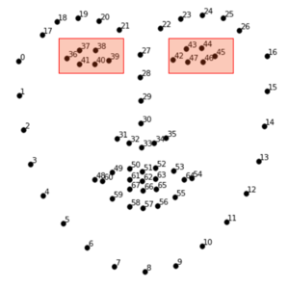
Face liveness detection
Step 4: Getting facial landmarks using dlib.
Well, to get started with blink detection we need to detect the eye first. We do this by using a pre-trained model which gives us 68 facial landmarks. We then map these landmarks on the face we detected in the previous step. We implement this in three parts. First, we load the contents of the pre-trained model in an object. Then we use this object to map the landmarks to the face detected in the frame and finally, we extract the Cartesian coordinates of these landmarks.

Slide 33
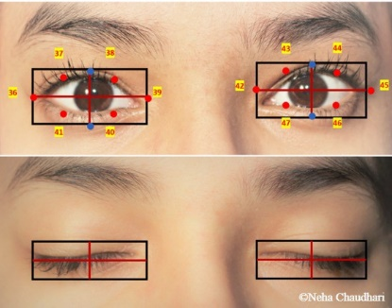
Face liveness detection
Step 5: Getting to know the Blink Ratio.
We are going to use the horizontal length to vertical length ratio of the imaginary bounding box of the eye. This is the BLINK RATIO
Here the threshold to detect a blink is 5.7. This value was decided empirically.

Slide 34
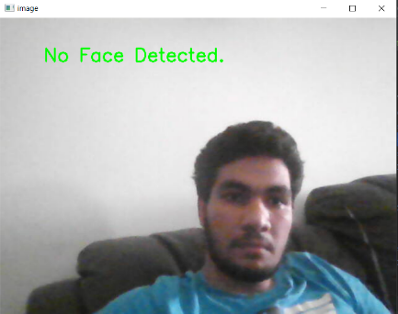
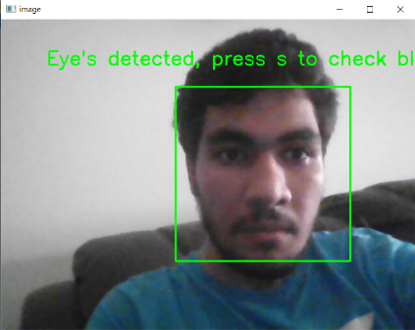
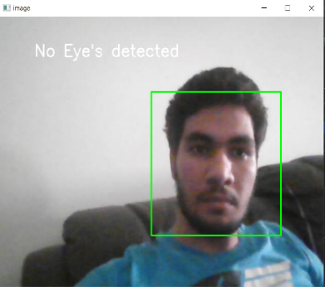
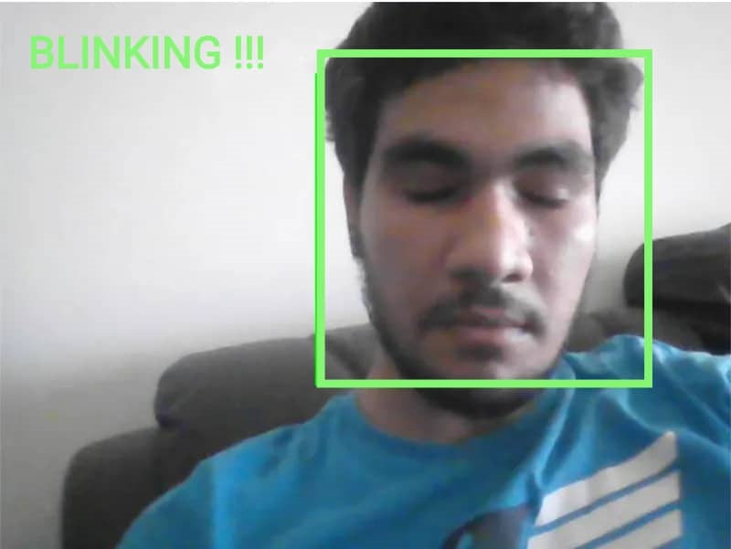
RESULT

Slide 35
Speech recognition

Slide 36

What Spaeech recognition ?
Speech Recognition incorporates computer science and linguistics to identify spoken words and converts them into text. It allows computers to understand human language.

Slide 37
How does it work
analyze the audio;
break it into parts;
digitize it into a computer-readable format;
use a deep learning and neural networks to match it to the most suitable text representation. The deep learning architecture are trained on different speech patterns, speaking styles, languages, dialects, accents and phrasings. The software also separates spoken audio from background noise that often accompanies the signal. To meet these requirements, speech recognition systems use two types of models:
Acoustic models. These represent the relationship between linguistic units of speech and audio signals.
Language models. Here, sounds are matched with word sequences to distinguish between words that sound similar.
École polytechnique de Tunisie

Slide 38
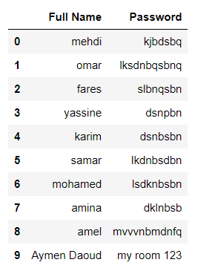
Dataset
École polytechnique de Tunisie

Slide 39
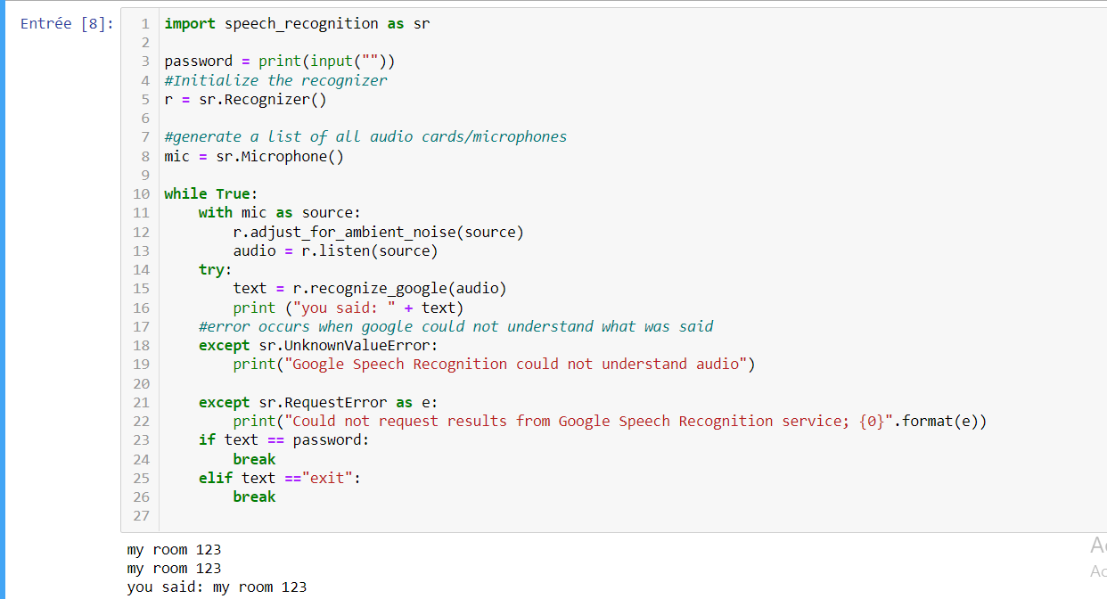
Speech recognition
Compare output and create exception

Slide 40
Speech recognition Challenges
Inconsistent performance. The systems may be unable to capture words accurately because of variations in pronunciation, lack of support for some languages and inability to sort through background noise
Speed. Some speech recognition programs take time to deploy and master. The speech processing may feel relatively slow.
Source file issues. Speech recognition success depends on the recording equipment used, not just the software.
École polytechnique de Tunisie

Slide 41
Conclusion & challenges
During this internship, I had the opportunity to discover new topics and AI techniques by working on KYC fraud detection Software that contains :
Liveness detection system that can detect if the person in front of the camera is real.
Face matching compares faces of different images.
also, we build a Data extraction system from Card ID using OCR (optical character recognition)
speech recognition system
Nevertheless, this project need improvement especially in OCR and speech recognition that can identify clients by their own voice
Also, we can work on the developpement of the plateform by using many framework in python like Django , Flask …
École polytechnique de Tunisie

Slide 42
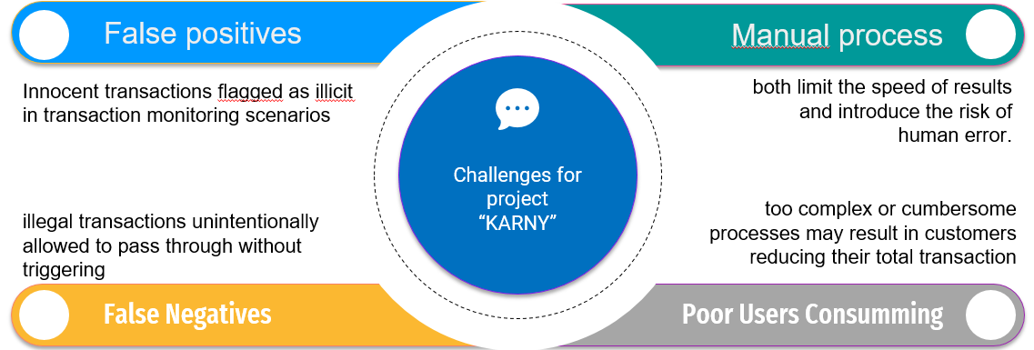
General Conclusion & challenges
École polytechnique de Tunisie

Slide 43
Thank you for your attention !
École polytechnique de Tunisie

